Slide 1


Team 37: Microhistological Analysis of the Dietary Habits of Sheep: GrazeView AI
Bi-Weekly Update 5
Godson Edewor, Arnav Gokhale, Jack Nelson, and Nate Scott Sponsor: John Lusher TA: Sabyasachi Gupta

Slide 2
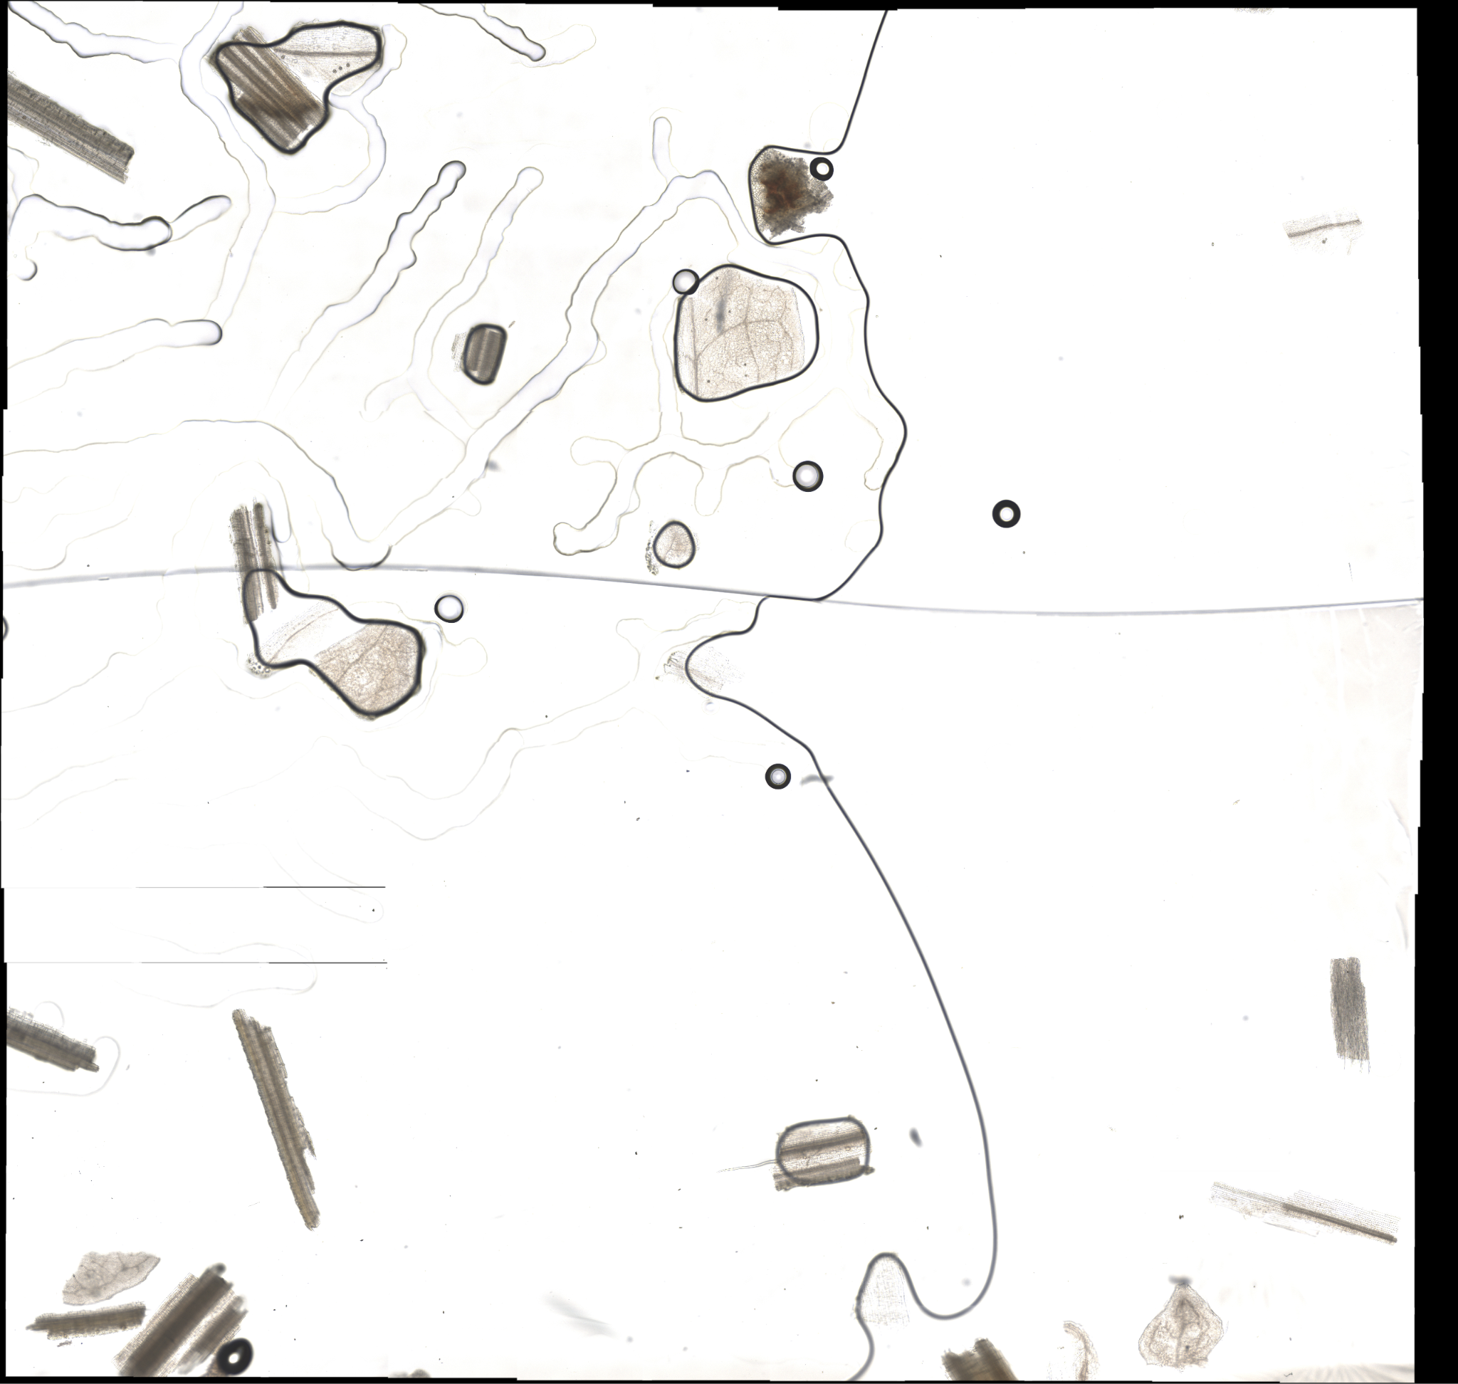
Project Summary
Problem Statement:
TAMU AgriLife is currently investigating the Dietary Habits of Sheep and the effect it has on their wool.
This can be a very time consuming effort, when analyzing microscopic samples by hand.
Solution Proposal:
GrazeView AI will allow the process of analyzing these microscope slides to become automated.
This will save TAMU AgriLife both time and money spent in training individuals that analyze by hand.

Slide 3
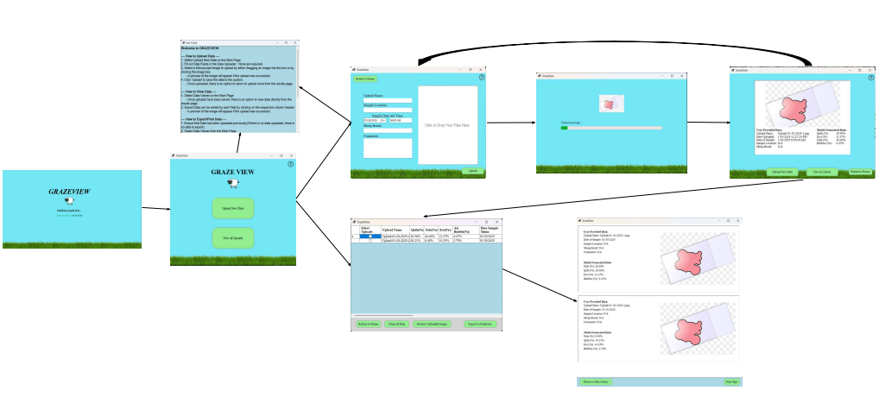
Integrated System Diagram

Slide 4
Project Timeline
Subsystem Final Validation (01/29) | Begin ML/UI Integration (02/03) | Finish ML/UI Integration Begin DB/UI Integration (02/17) | Finalize DB/UI Integration Fix Integration Errors (03/03) | Project-wide Validation (03/24) | Validate Until Demo | Demo and Report (04/16)
*All Dates represent completion

Slide 5
User Interface & Machine Learning & Database
Godson Edewor, Jack Nelson, Nate Scott, Arnav Gokhale
Accomplishments since last update [~35 Hours] | Ongoing progress/problems and plans until the next presentation
GrazeView Final Model developed and embedded GrazeView Installer created GrazeView Driver Installation embedded Output sync speed with GrazeView database massively increased using Microsoft ODBC Driver 18 | Final Application-Wide Testing Complete research paper

Slide 6
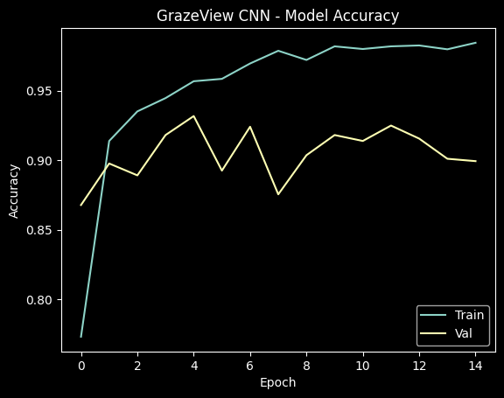
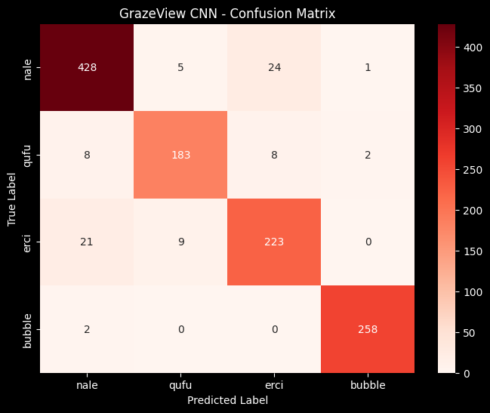
User Interface & Machine Learning & Database
Godson Edewor, Jack Nelson, Nate Scott, Arnav Gokhale

Slide 7
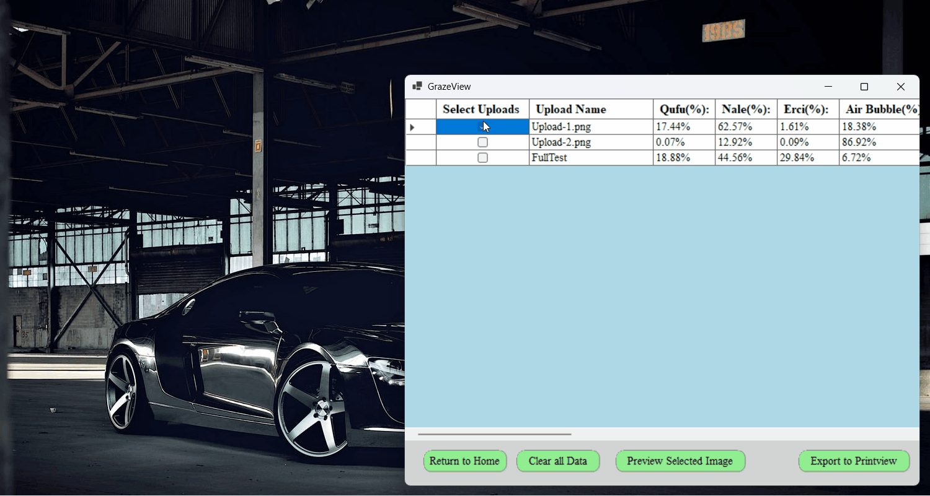
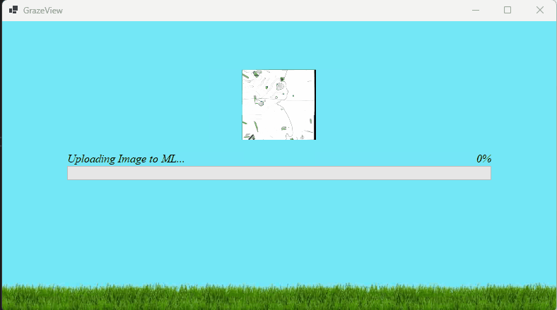
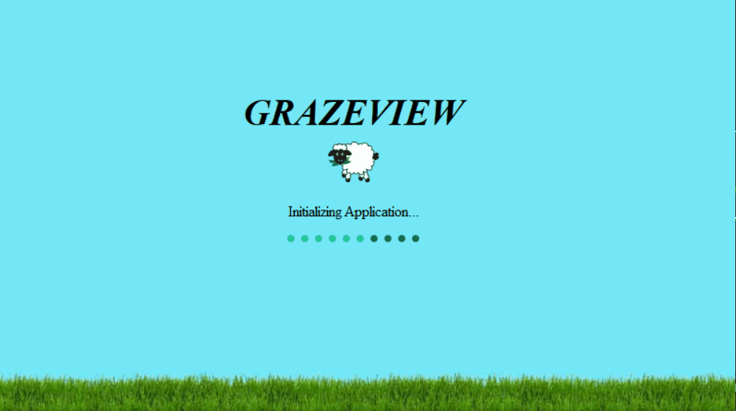
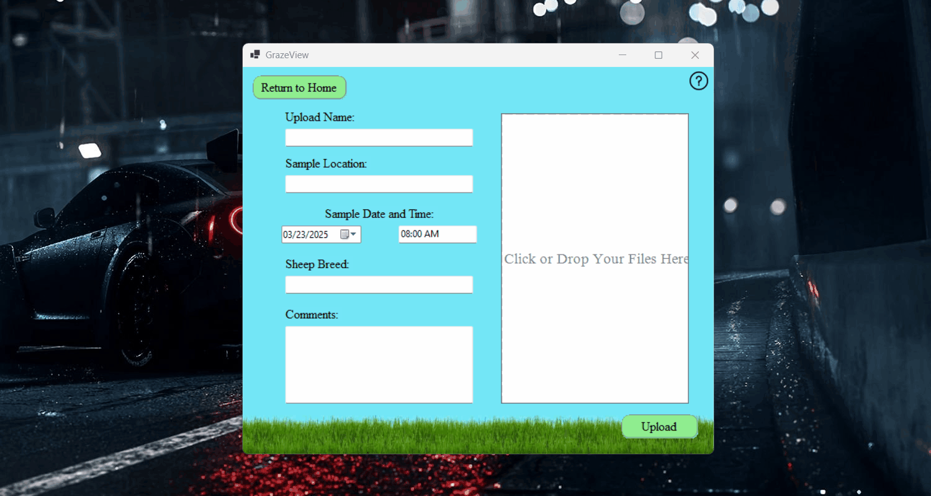
User Interface & Machine Learning & Database
Godson Edewor, Jack Nelson, Nate Scott, Arnav Gokhale

Slide 8
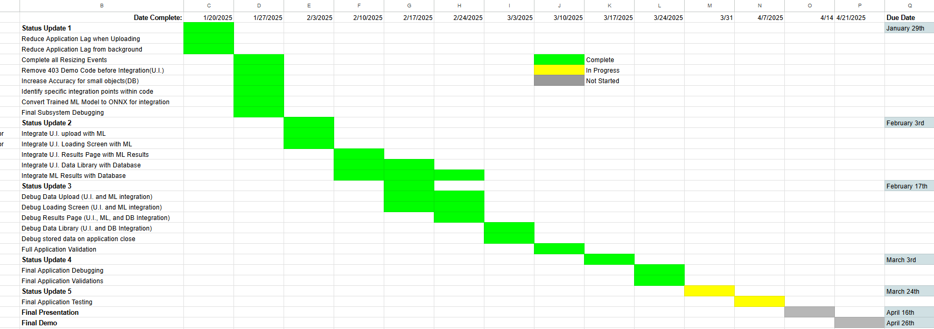
Execution Plan
Notes:
Michelle

Slide 9
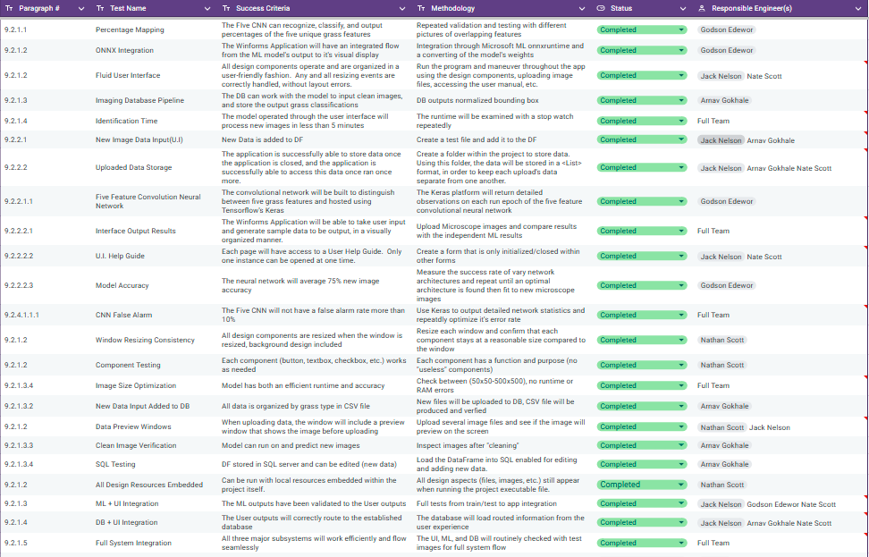
System Validation Plan
Notes:
Michelle

Slide 10
Questions?

